Slide 1
고양이 귀 씌우기
20205178 박 현

Slide 2
목 차
프로그램 개요 및 다이어그램
단일 이미지 실행 결과
함수에 관한 설명
시연

Slide 3
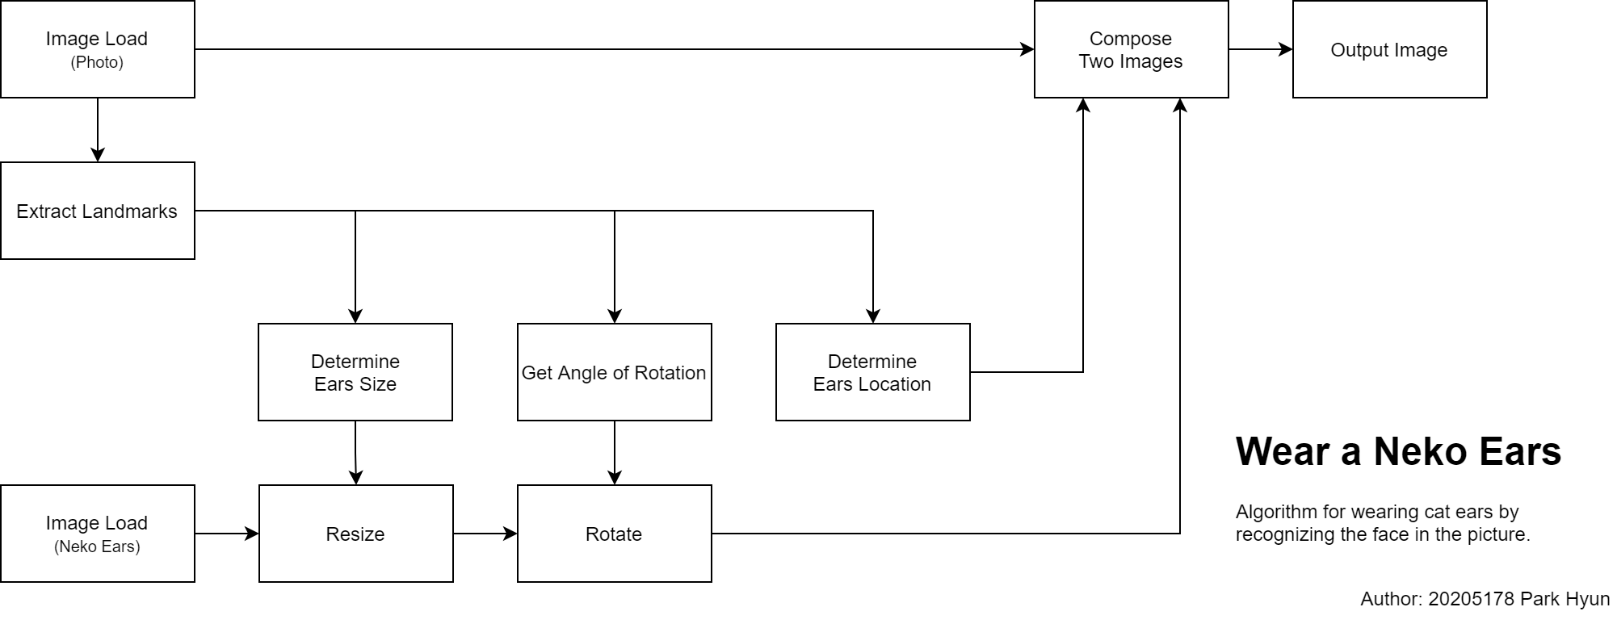
프로그램 개요

Slide 4
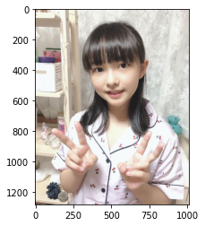
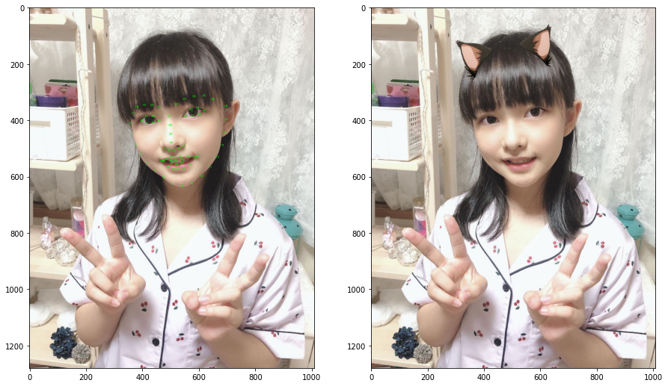
단일 이미지 실행 결과
import cv2
import dlib
import matplotlib.pyplot as plt
import numpy as np
import sys, os
sys.path.append(os.path.dirname(os.getcwd()))
from toolkit.transformation import rotate_image, paste_image
from toolkit.measurement import get_rotation
from math import sin, radians
detector = dlib.get_frontal_face_detector()
predictor = dlib.shape_predictor("..\landmarks\shape_predictor_68_face_landmarks.dat") image = cv2.imread("../sample.jpg")
plt.imshow(cv2.cvtColor(image, cv2.COLOR_BGR2RGB))
plt.show()
landmarked_image = image.copy()
masked_image = image.copy()
ears_orig = cv2.imread(r"..\dataset\neko_ears\6570766_preview.png")
faces = detector(landmarked_image)
for face_index, face in enumerate(faces):
landmark = predictor(landmarked_image, face)
for i in range(landmark.num_parts):
x = landmark.part(i).x
y = landmark.part(i).y
cv2.putText(landmarked_image, str(i), (x, y),
cv2.FONT_HERSHEY_SCRIPT_SIMPLEX, 0.3, (0, 255, 0))
ears = ears_orig.copy()
p1 = (landmark.part(0).x, landmark.part(0).y)
p2 = (landmark.part(16).x, landmark.part(16).y)
distance = ((p1[0]-p2[0])**2 + (p1[1]-p2[1])**2) ** 0.5
distance = int(distance)
ratio = distance / ears.shape[1]
dim = (distance, int(ears.shape[0] * ratio))
resized = cv2.resize(ears, dim, interpolation=cv2.INTER_NEAREST)
rot = get_rotation(image)
ears = rotate_image(resized, rot)
start = p1[0]-int(resized.shape[1]*sin(radians(rot)))
masked_image = paste_image(image, ears, [start, 60])
fig = plt.figure(figsize=(15, 10))
ax1 = fig.add_subplot(121)
ax1.imshow(cv2.cvtColor(landmarked_image, cv2.COLOR_BGR2RGB))
ax2 = fig.add_subplot(122)
ax2.imshow(cv2.cvtColor(masked_image, cv2.COLOR_BGR2RGB))
plt.show()
Out [1]:
Out [2]:

Slide 5
함수 설명
import dlib
import math
faceDetector = dlib.get_frontal_face_detector()
landmarkDetector = dlib.shape_predictor("landmarks/shape_predictor_5_face_landmarks.dat")
def get_rotation(img):
faceRects = faceDetector(img, 0)
landmarks = landmarkDetector(img, faceRects[0])
rightEye = landmarks.part(2)
leftEye = landmarks.part(0)
deg = math.atan( (leftEye.y - rightEye.y) / (leftEye.x - rightEye.x) )
return -deg*180/math.pi
[ File ]
toolkit/measurement.py
[ Reference ]
https://stackoverflow.com/a/34799671/14669574
myFace_Alignment.ipynb (week 13)

Slide 6
함수 설명
def paste_image(img, to, location):
"""
Args:
img: 이미지
to: img위에 덮을 투명 이미지.
location: 덮을 위치.
"""
result = img.copy()
mask_img = np.zeros_like(to, dtype='uint8')
mask_img[np.where(to[:,:,:]!=0)]=255
mask_img = cv2.bitwise_not(mask_img)
orig_rows, orig_cols, orig_channels = img.shape
mask_rows, mask_cols, mask_channels = mask_img.shape
loc_x, loc_y = location
temp = result[loc_y:loc_y+mask_rows, loc_x:loc_x+mask_cols, :]
temp = cv2.bitwise_and(temp, mask_img)
temp = cv2.add(temp, to)
result[loc_y:loc_y+mask_rows, loc_x:loc_x+mask_cols, :] = temp
return result
[ File ]
toolkit/transformation.py
[ Reference ]
https://blog.naver.com/samsjang/220503082434

Slide 7
함수 설명
def rotate_image(mat, angle):
# mat : 입력 영상
# angle : 회전 각도
height, width = mat.shape[:2]
image_center = (width/2, height/2)
# 회전 행렬 생성
rotation_mat = cv2.getRotationMatrix2D(image_center, angle, 1.)
# angle 만큼 회전 했을 때의 cos값과 sin값의 절댓값을 구함
abs_cos = abs(rotation_mat[0,0])
abs_sin = abs(rotation_mat[0,1])
# 각 꼭짓점이 변에 맞떨어지게 끔 할려구 사이즈 조절.
bound_w = int(height * abs_sin + width * abs_cos)
bound_h = int(height * abs_cos + width * abs_sin)
# 그대로 쓰면 이미지가 이상한 곳에 있어서 잘려버리니까 안잘리도록 이미지를 정중앙으로 평행이동
rotation_mat[0, 2] += bound_w/2 - image_center[0]
rotation_mat[1, 2] += bound_h/2 - image_center[1]
# 이미지를 위에서 구한 행렬을 이용해 변환
rotated_mat = cv2.warpAffine(mat, rotation_mat, (bound_w, bound_h))
return rotated_mat
[ File ]
toolkit/transformation.py
[ Reference ]
7_GeometricXorm.ipynb (week 7) | Assignments 2 : rotate_image

